Slide 1
Predictive Modeling of Lung Cancer Outcomes Using R: A Machine Learning Approach
Mahalakshmi Aranganathan

Slide 2


Introduction
Lung cancer is one of the most common and deadliest cancers globally.
It is responsible for nearly 1 in 5 cancer-related deaths worldwide.
The two main types are:
Non-small cell lung cancer (NSCLC) – most common (~85%)
Small cell lung cancer (SCLC) – more aggressive but less common
Tobacco smoking is the leading risk factor, along with environmental and genetic influences.
Early diagnosis and personalized treatment are crucial for improving patient survival.
Predictive modeling and survival analysis can assist clinicians in making data-driven treatment decisions.

Slide 3
🎯 Objective of the Project
To predict lung cancer survival using clinical data by comparing machine learning models and identifying the most influential treatment and patient-related factors.
making it easier to identify patterns, trends, and outliers

Slide 4
Data
📊 Data Source
The dataset was sourced from [TCGA (The Cancer Genome Atlas)], a well-established resource for genomic and clinical cancer data.
Focused on lung cancer patient records, particularly clinical features related to diagnosis and outcomes.
📁 Dataset Overview
Included a wide range of clinical features such as:
Demographics: age, gender, race
Clinical Information: tobacco_smoking_status, ajcc_pathologic_stage, treatment_type
Outcome Data: vital_status (Alive/Dead), survival_time, event
Preprocessing steps:
Data cleaning & formatting
Handling missing values
Feature selection and transformation

Slide 5
Classification models to predict vital_status
A classification model is a type of machine learning model used to predict categorical outcomes. In my case, the model is predicting whether a lung cancer patient is alive, or dead based on clinical features such as:
AJCC pathologic stage
Smoking status
Race
Treatment type
Gender
The outcome (vital_status) has two classes:
Alive
Dead
Logistic Regression
Predicts outcome using log-odds.
Good for interpretability (odds ratios).
Assumes linear relationships.
May underperform on complex data.
Decision Tree
Splits data into if-then rules.
Highly interpretable.
Prone to overfitting on small datasets.
Random Forest
Builds many trees → averages predictions.
Handles nonlinear data well.
Offers feature importance.
Less interpretable than a single tree.

Slide 6
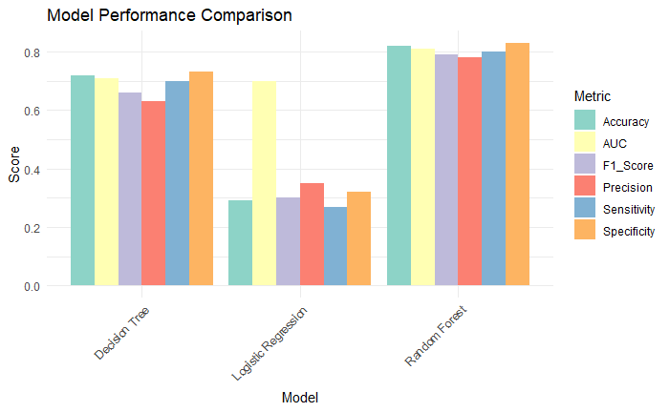
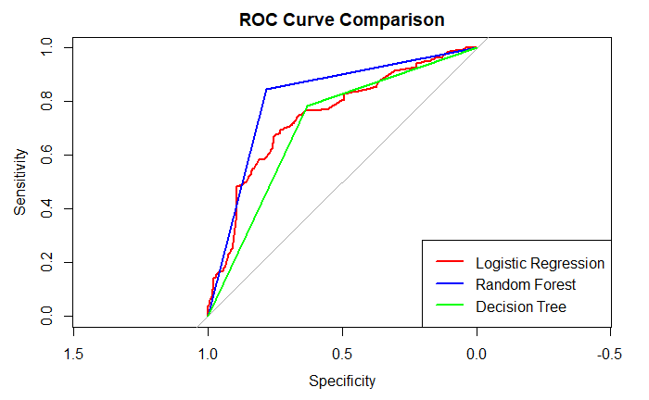
Comparative Evaluation of Classification Models
The Random Forest model has the best overall performance with the highest area under the curve (AUC), indicating superior classification ability. Logistic Regression and Decision Tree perform moderately, with Decision Tree showing the lowest sensitivity-specificity tradeoff.
Random Forest outperforms both Logistic Regression and Decision Tree across all metrics, with the highest accuracy, AUC, and F1-score. Logistic Regression performs the weakest, while Decision Tree shows moderate but consistent performance.

Slide 7
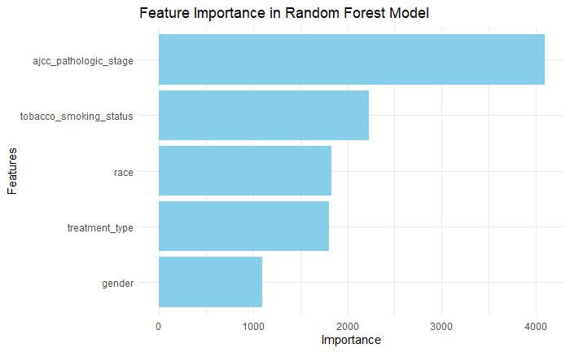
Key Predictors in Random Forest Model
This bar chart illustrates the relative importance of features used in the classification-based Random Forest model. The importance scores are based on Mean Decrease in Accuracy, which quantifies the drop in the model’s classification performance when a particular feature is randomly shuffled. A higher score indicates that the feature plays a more crucial role in correctly predicting the target class. This visualization helps identify which predictors are most influential in the decision-making process of the model.

Slide 8
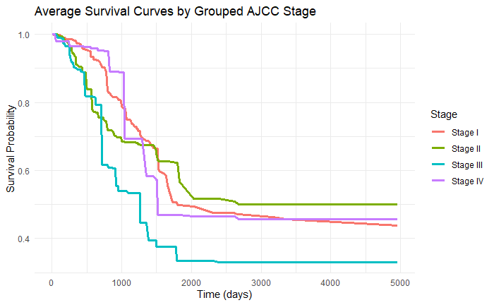
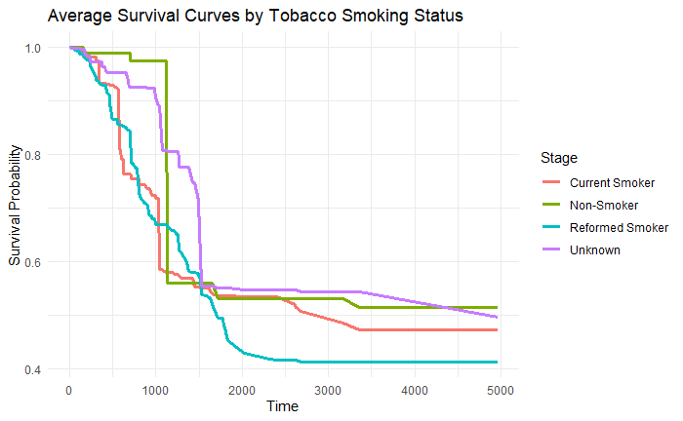
Kaplan–Meier Survival Curves
Stage I: Highest survival probability over time.
Stage II: Slightly lower survival than Stage I
Stage III (cyan/blue): Steeper drop, meaning survival decreases faster.
Stage IV (purple): A steep drop initially, but flattens out later
Non-Smokers: Best survival outcomes.
Current Smokers: Steep decline, poor prognosis.
Reformed Smokers: Early drop in survival, possibly late quitting.

Slide 9

Key Takeaways and Conclusion
Random Forest achieved the highest accuracy and AUC, making it the most reliable model.
AJCC Stage and smoking status were the strongest predictors of survival.
Non-smokers and patients in early cancer stages had better long-term survival.
Logistic Regression was limited by its linear assumptions; Decision Trees offered interpretability but less accuracy.
Machine learning can play a vital role in personalized treatment planning for lung cancer patients.

Slide 10
Thanks!
Do you have any questions?

